Slide 1
Operators and Expressions and Control Statements in C#

Slide 2
Introduction
Operators
Type Casting
Type Conversion
Boxing/Unboxing
Program Control Statements

Slide 3
Operators
C# supports a rich set of operators. C# Operators can be classified into a number of related categories as below:-
Arithmetic
Relational
Logical
Assignment
Increment and Decrement
Conditional
Bitwise
Special

Slide 4
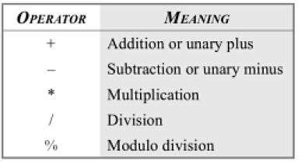
Arithmetic Operators

Slide 5
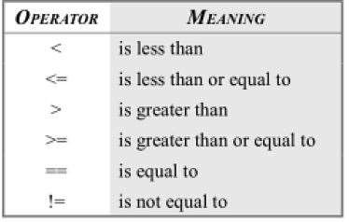
Relational Operators

Slide 6
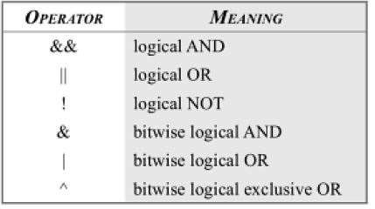
Logical Operators

Slide 7
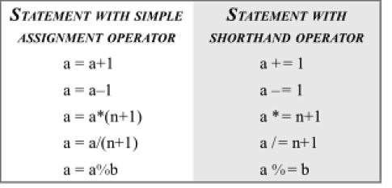
Compound Assignment Operator

Slide 8
Increment and Decrement Operator
using System; class incdecop
{
public static void Main()
{
int x=10,y=30; Console.WriteLine(“x= “ +x); Console.WriteLine(“y= “ +y); Console.WriteLine(“++x= “ ++x); Console.WriteLine(“++y= “ ++y); Console.WriteLine(“x++= “ x++); Console.WriteLine(“y++= “ y++); Console.WriteLine(“x= “ -x); Console.WriteLine(“y= “ -y); Console.WriteLine(“--x= “ --x);
Console.WriteLine(“--y= “ --y);
Console.WriteLine(“x--= “ x--);
Console.WriteLine(“y--= “ y--);
}
}

Slide 9
Conditional Operators
➢The character pair ? : is a ternary operator available in C#. This operator is used to construct conditional expression of the form
exp1 ? exp2 : exp3
➢exp1 is evaluated first. If it is true , then the expression exp2 is evaluated and becomes the value of the conditional expression.
➢If exp1 is false, exp3 is evaluated and its value becomes the value of the conditional expression.
➢ Note that only one of the expressions is evaluated.
int x=90; int y=98;
z=(x>y)? x: y;

Slide 10
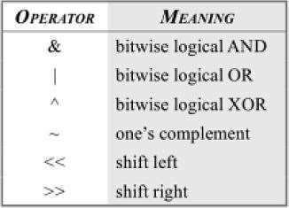
Bitwise Operators

Slide 11
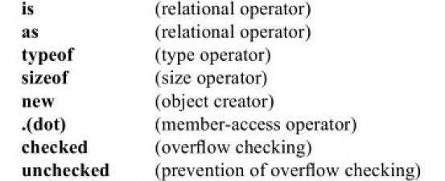
Special Type

Slide 12
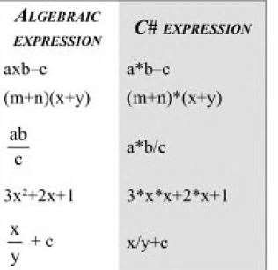
Arithmetic Expression

Slide 13
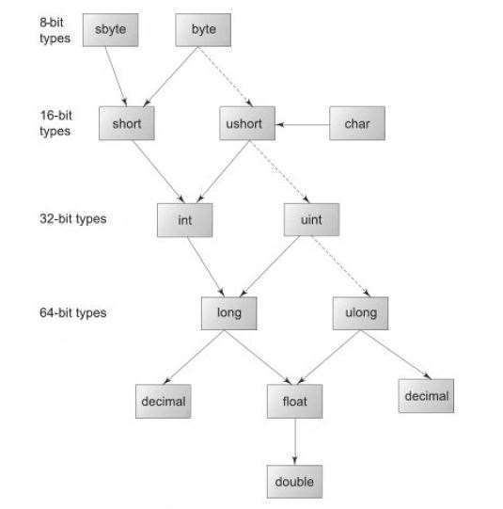
C# Conversion Chart

Slide 14
Explicit Conversion
int to short
int to uinit
uint to int
float to int
decimal to any numeric type
Any numeric type to char
Syntax: (target-type)expression
int x= 60;
byte y =(byte)x;

Slide 15
Use of Casting Operation
using System; class CastDemo
{
public static void Main()
{
int sum;
double x, y;
x=6.5;
y=2.5;
sum= (int)x/y; // x/y=2.6 but sum will be 2
Console.WriteLine(“Sum=“ +sum); //Sum= 2
}
}

Slide 16
Boxing and Unboxing
C# provides us with Value types and Reference Types. Value Types are stored on the stack and Reference types are stored on the heap. The conversion of value type to reference type is known as boxing and converting reference type back to the value type is known as unboxing.
Value Types
Value types are primitive types that are mapped directly to the FCL(Framework Class Library). Like Int32 maps to System.Int32, double maps to System.double. All value types are stored on stack and all the value types are derived from System.ValueType. All structures and enumerated types that are derived from System.ValueType are created on stack, hence known as ValueType.

Slide 17
Reference Types
Reference Types are different from value types in such a way that memory is allocated to them from the heap. All the classes are of reference type. C# new operator returns the memory address of the object. Boxing and unboxing is an essential concept in C#’s type system. With Boxing and unboxing one can link between value-types and reference-types by allowing any value of a value-type to be converted to and from type object. Boxing and unboxing enables a unified view of the type system wherein a value of any type can ultimately be treated as an object.
Sometimes we need to convert ValueTypes to Reference Types also known as boxing. "implicit boxing" means you don't need to tell the compiler that you are boxing Int32 to object because it takes care of this itself although you can always make explicit boxing:
Int32 x = 10; object o = x ; // Implicit boxing Int32 y = 10; object obj = (object) y; // Explicit Boxing
x = o; // Implicit UnBoxing

Slide 18
C# provides a unified type system. All types including value types derive from the type object. It is possible to call object methods on any value, even values of primitive types such as int. An int value can be converted to object and back again to int.
This example shows both boxing and unboxing. When a variable of a value type needs to be converted to a reference type, an object box is allocated to hold the value, and the value is copied into the box. Unboxing is just the opposite. When an object box is cast back to its original value type, the value is copied out of the box and into the appropriate storage location.

Slide 19
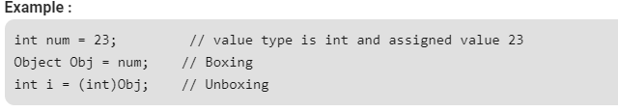
boxing and unboxing
The process of Converting a Value Type (char, int etc.) to a Reference Type(object) is called Boxing.
Boxing is implicit conversion process in which object type (super type) is used. Object is the base class for all the data types in C#.
The Value type is always stored in Stack. The Referenced Type is stored in Heap
In C#, all types, predefined and user-defined, reference types and value types, inherit directly or indirectly from Object.
The process of converting reference type into the value types known as unboxing.

Slide 20
boxing and unboxing
using System;
namespace ValueTypeTest {
class BoxingUnboxing {
static void Main()
{
int num=20;
// declare object obj
object obj=num; //implicit conversion to System.object (boxing)
num = 30;
Console.WriteLine(num); // 30
Console.WriteLine(obj); //20
// to show type of object by using GetType()
Console.WriteLine(obj.GetType()); //System.Int32
int i= (int)obj; // explicit conversion from object to int (unboxing)
Console.WriteLine(i); //20
}
}
}

Slide 21
Program control Statements
There are three categories of program control statements
Selection statements : if and switch
Iteration statements : consist of for, while, do-while, foreach loops
Jump statements: break, continue, goto, return, throw
All the above statements of C# are same as in C/C++ and Java except foreach loop
Foreach loop cycles through the elements of a collection.
A collection is a group of objects.
C# defines several types of collections, of which one is an array
class LoopsDemo
{
static void Main()
{
int[] even={2,4,6,8,10};
Console.WriteLine(“Even Numbers);
foreach (int n in even)
{
Console.WriteLine(n);
}
}
}

Slide 22
Thanks

